Slide 1
OWASP IoT Project
The OWASP Internet of Things Project is designed to help manufacturers, developers, and consumers better understand the security issues associated with the Internet of Things, and to enable users in any context to make better security decisions when building, deploying, or assessing IoT technologies.
https://www.owasp.org/index.php/OWASP_Internet_of_Things_Project

Slide 2
What is IoT?
“A proposed development of the Internet in which everyday objects have network connectivity, allowing them to send and receive data.”

Slide 3


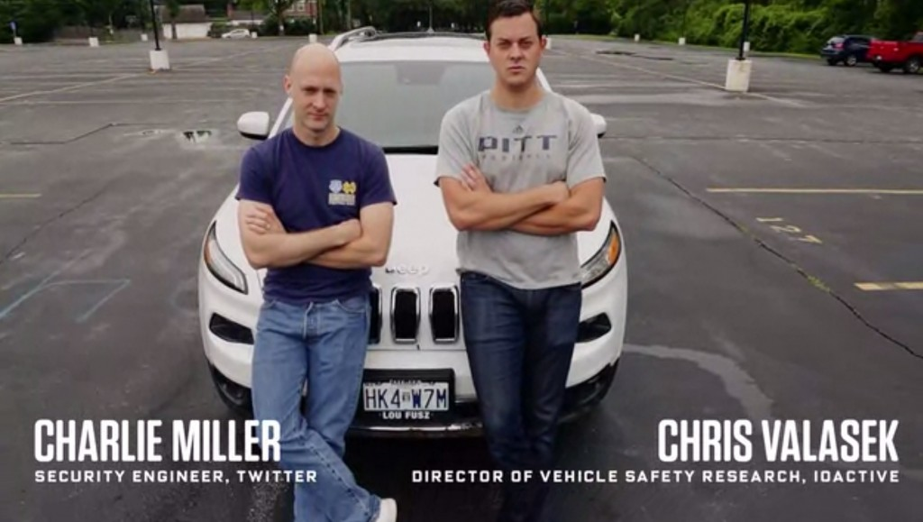
IoT is More than Consumer
Hardware hacking
“Junk hacking”
“Stunt hacking”

Slide 4




IoT Beyond the Hype
Municipal IoT
Smart cities
Smart grid
Industrial IoT
Connected factories
Agriculture
Logistics
Medical IoT
Smart hospitals
Electronic medical records

Slide 5

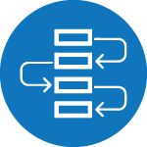





The Power of IoT
Big data provide analytics
Business process optimizations
Multiple concurrent access

Slide 6
The Challenge of IoT Security
IoT is an evolutionary technology
IoT
Cloud
Mobile
Web
Network
Operating System
Hardware

Slide 7
Why it Looks so Bad
Breakers have a long history and robust tools
Automated network attack tools
Exploits for most segments of IoT stack
Physical access and hardware hacking
Builders are still searching for
Secure toolkits
Proven methodologies
Successful models
Result:
Builders cobble together components
Build very fragile full stack solutions
No visibility into security or attack surface
Attackers have a field day

Slide 8

Miserable Track Record Thus far
Luckily most tests are of consumer IoT
http://www8.hp.com/h20195/V2/GetPDF.aspx/4AA5-4759ENW.pdf
Testing industrial, municipal, and other IoT is much trickier
Most have heterogeneous brownfield deployments
Testers can’t just pop down to Walmart to get access to these deployments
SecuringSmartCities.org has done some testing
If history is a guide though things probably aren’t good

Slide 9
OWASP IoT Project
An overall IoT security effort
Attack surfaces (present)
Vulnerability lists (working)
Reference solutions (coming)
Aggregates community resources
Guidance for developers
IoT specific security principles
IoT framework assessment

Slide 10
OWASP IoT Top 10
Category | IoT Security Consideration | Recommendations
I1: Insecure Web Interface | Ensure that any web interface coding is written to prevent the use of weak passwords … | When building a web interface consider implementing lessons learned from web application security. Employ a framework that utilizes security …
I2: Insufficient Authentication/Authorization | Ensure that applications are written to require strong passwords where authentication is needed … | Refer to the OWASP Authentication Cheat Sheet
I3: Insecure Network Services | Ensure applications that use network services don't respond poorly to buffer overflow, fuzzing … | Try to utilize tested, proven, networking stacks and interfaces that handle exceptions gracefully...
I4: Lack of Transport Encryption | Ensure all applications are written to make use of encrypted communication between devices… | Utilize encrypted protocols wherever possible to protect all data in transit…
I5: Privacy Concerns | Ensure only the minimal amount of personal information is collected from consumers … | Data can present unintended privacy concerns when aggregated…
I6: Insecure Cloud Interface | Ensure all cloud interfaces are reviewed for security vulnerabilities (e.g. API interfaces and cloud-based web interfaces) … | Cloud security presents unique security considerations, as well as countermeasures. Be sure to consult your cloud provider about options for security mechanisms…
I7: Insecure Mobile Interface | Ensure that any mobile application coding is written to disallows weak passwords … | Mobile interfaces to IoT ecosystems require targeted security. Consult the OWASP Mobile …
I8: Insufficient Security Configurability | Ensure applications are written to include password security options (e.g. Enabling 20 character passwords or enabling two-factor authentication)… | Security can be a value proposition. Design should take into consideration a sliding scale of security requirements…
I9: Insecure Software/Firmware | Ensure all applications are written to include update capability and can be updated quickly … | Many IoT deployments are either brownfield and/or have an extremely long deployment cycle...
I10: Poor Physical Security | Ensure applications are written to utilize a minimal number of physical external ports (e.g. USB ports) on the device… | Plan on having IoT edge devices fall into malicious hands...

Slide 11
Principles of IoT Security
Assume a hostile edge
Test for scale
Internet of lies
Exploit autonomy
Expect isolation
Protect uniformly
Encryption is tricky
System hardening
Limit what you can
Lifecycle support
Data in aggregate is unpredictable
Plan for the worst
The long haul
Attackers target weakness
Transitive ownership
N:N Authentication

Slide 12

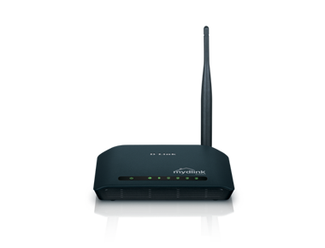
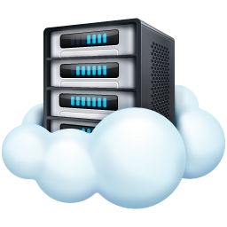
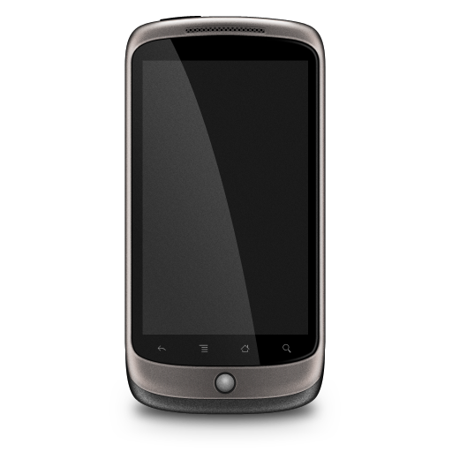
Framework assessment
Based on a prototypical IoT deployment model
Designed like a checklist or benchmark

Slide 13
Example Edge Considerations
Are communications encrypted?
Is storage encrypted?
How is logging performed?
Is there an updating mechanism?
Are there default passwords?
What are the offline security features?
Is transitive ownership addressed?

Slide 14
Example Gateway Considerations
Is encryption interrupted?
Is there replay and denial of service defensive capabilities?
Is there local storage? Is it encrypted?
Is there anomaly detection capability?
Is there logging and alerting?

Slide 15
Example Cloud Considerations
Is there a secure web interface?
Is there data classification and segregation?
Is there security event reporting?
How are 3rd party components tracked/updated?
Is there an audit capability?
Is there interface segregation?
Is there complex, multifactor authentication allowed?

Slide 16
Example Mobile Considerations
What countermeasures are in place for theft or loss of device?
Does the mobile authentication degrade other component security?
Is local storage done securely?
Is there an audit trail of mobile interactions?
Can mobile be used to enhance authentication for other components?

Slide 17
Final Thoughts
Privacy in realms of big data is a problem
No real technical solution to this one
Regulation is probably coming
FTC set to release guidelines next year
Consumers may eschew security but business won’t
Security can be a differentiator

Slide 18




Other Organizations

Slide 19
Questions?

